Slide 1
Project 18-40
SNIC Bifurcation and its Applications to MEMS
By: Shay Kricheli
Supervisor: Dr. Oriel Shoshani
21.6.18

Slide 2
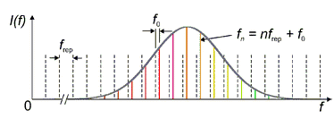
Introduction
Generation of a Frequency Comb
A set of discrete equally spaced frequencies

Slide 3
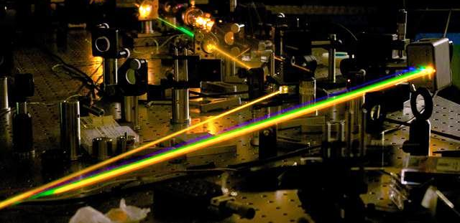
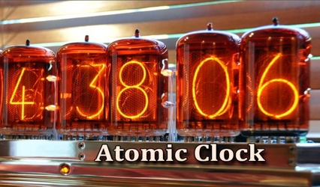
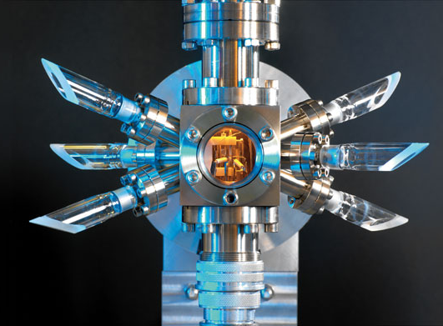
Applications
Spectroscopy
What can we do with it?
Transition from one frequency range to another
Optical and Atomic clocks
Precision Spectroscopy
Precision microwave generation
Optical Clock

Slide 4
Motivation
Why mechanically?
Electrical systems produce noise – corresponding to a poor comb
Optical systems are expensive to implement
A mechanical model is more precise

Slide 5
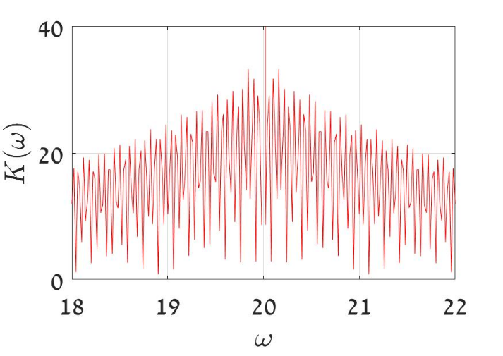
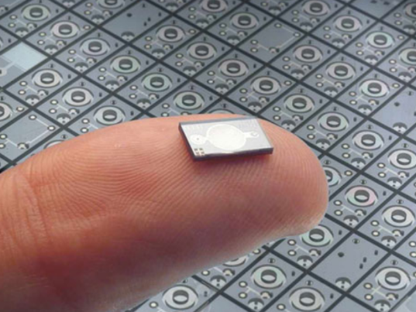
Project Goals
Producing a frequency comb by mechanical means
Using a simple dynamic model
Verifying the model’s validity
Providing insight on usage with MEMS

Slide 6
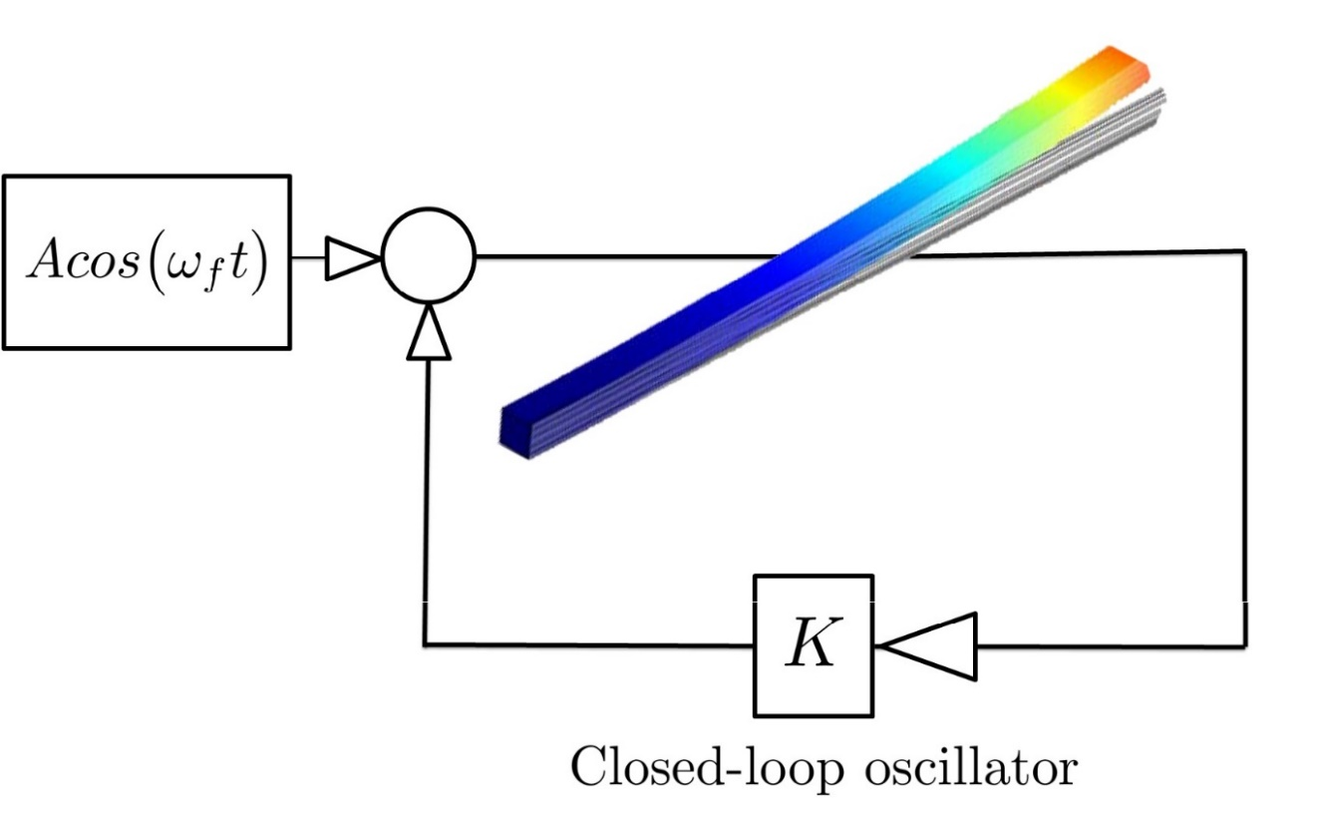
Methods of Execution
Vibration analysis of a MEMS beam exhibiting non-linear dynamics for a formation of a limit cycle
Use of closed loop control to maintain the beam at steady amplitude
External perturbation of the beam
Causing a SNIC bifurcation
Forming the desired frequency comb

Slide 7
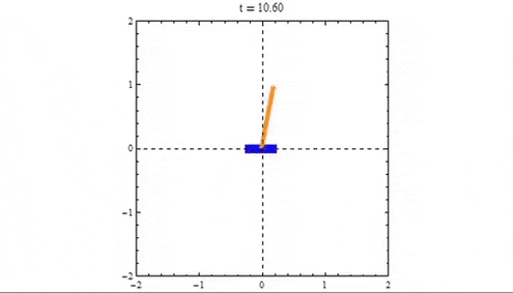
What is a Bifurcation?
An abrupt qualitive change in a behavior of a dynamical system due to a change in one of its governing parameters.
It can add, merge or remove equilibrium points
Inverted pendulum exhibiting a bifurcation

Slide 8
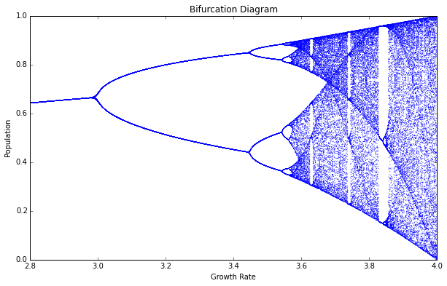
Bifurcation Example The Logistic Map
Models population growth and decay using an iterative equation governed by $r$ – the growth rate

Slide 9
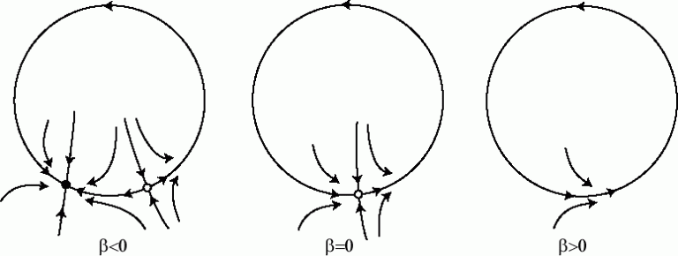
SNIC Bifurcation
Saddle-Node on Invariant Circle is a bifurcation where two equilibrium points collide and cause the system to settle on an infinite limit cycle

Slide 10
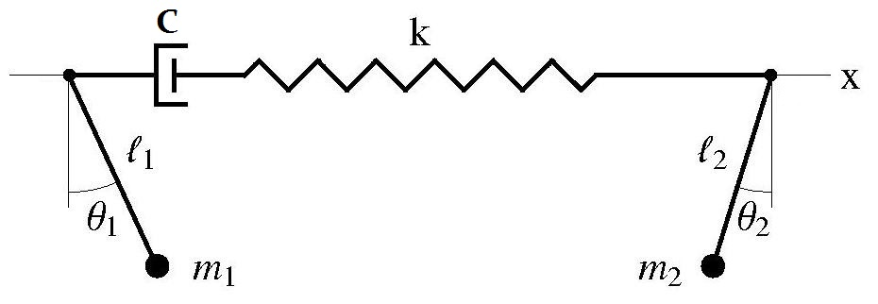
How will SNIC help us get the comb?
Driver frequency slightly detuned from the beam’s eigenfrequency
Due to effects of injection pulling, a SNIC bifurcation will occur for certain physical parameters of the beam
In the bifurcation critical point, where the oscillators are close to locking – the frequency comb will appear

Slide 11
Mathematical Modeling
A model from Ron Lifshitz and M. C. Cross. “Nonlinear Dynamics of Nanomechanical and Micromechanical Resonators”
The beam is taken to be clamped-clamped so the boundary conditions are

Slide 12
Spatial Function Solution
We assume:
Variable Separation
Single Mode Assumption for the first mode
Yielding the shape function of the beam’s first mode

Slide 13
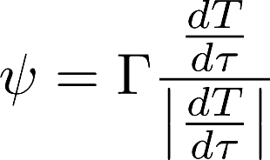
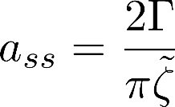
Temporal Function Solution
Normalizing with respect to time and length results in the following equation for the time dynamics
Duffing non-linear term
Damping term
External driver
Second derivative with respect to normalized time
Linear term
Closed loop control function
Using a model from Seshia, we take the Signum function to cancel out the damping

Slide 14
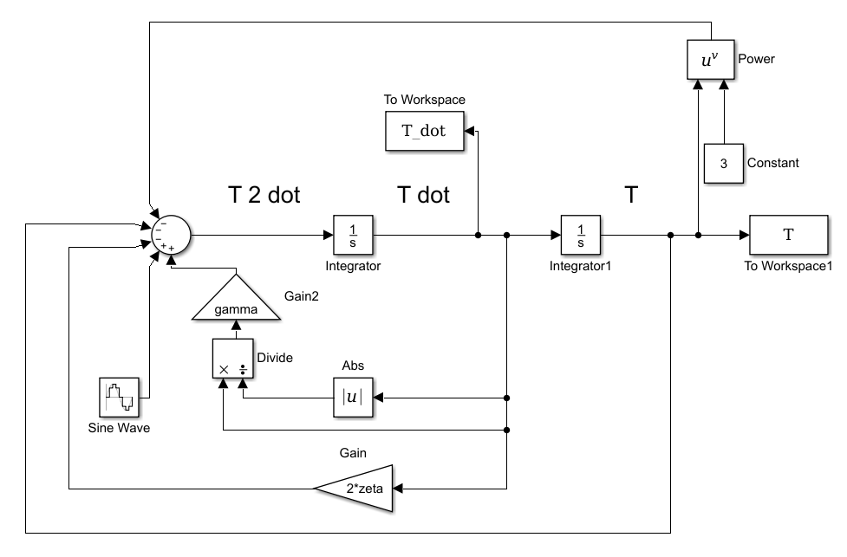
Validation of the Model
The final equation Simulink model

Slide 15
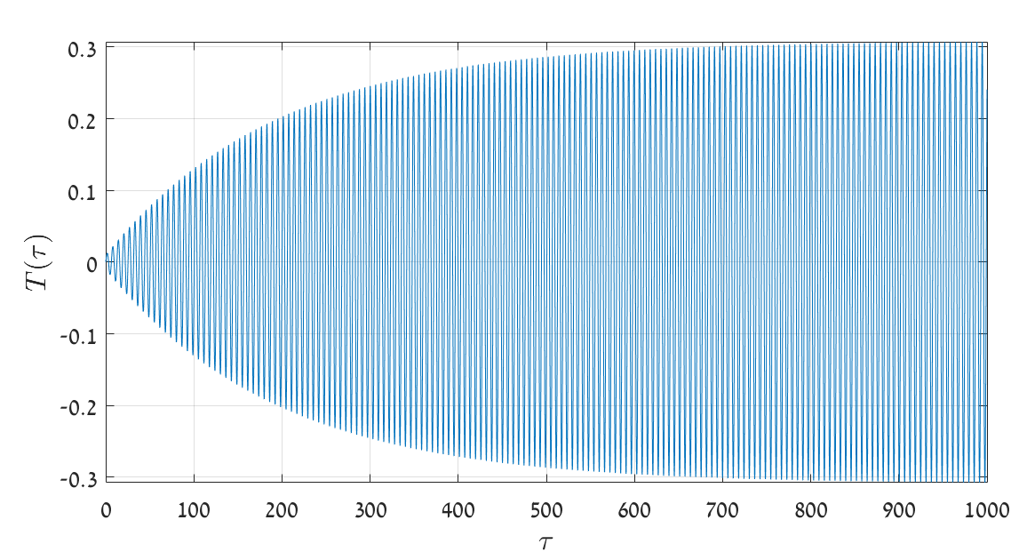
SS Amplitude Simulations 1
Taking $Γ= \frac{\tilde{ζ}}{2}$ we get a period of $\frac{1}{π}≈0.3$

Slide 16
SS Amplitude Simulations 2
Phase space shows a limit cycle of $≈0.3$

Slide 17
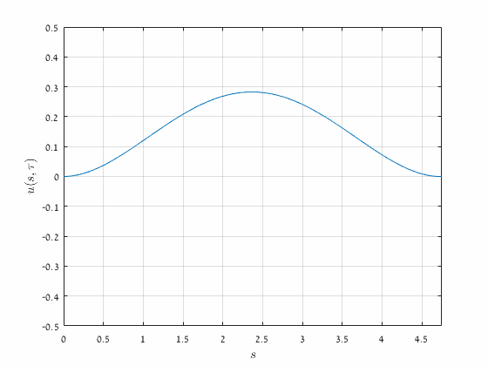
Solution for $u(x,t)$
Using the solution for the spatial and temporal functions

Slide 18
So we get a steady limit cycle, and with a small driver we can get the SNIC! Now we just have to solve the equation to get the dynamics of the beam and derive the phase pull But.. Even the simple Duffing equation is not solvable
Mid Results

Slide 19
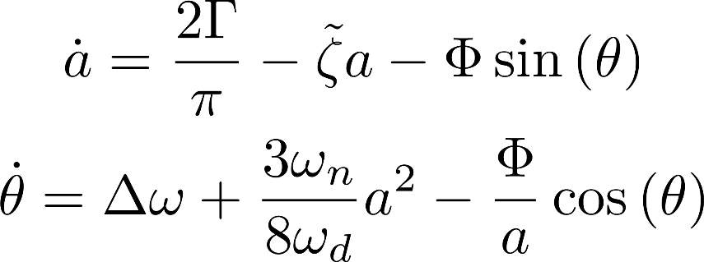
Slow Evolution Model
Using a model of Ashwin A. Seshia for the temporal function
Where the functions obey

Slide 20
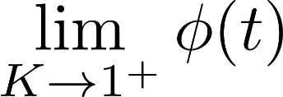
The Adler Equation
Assuming the amplitude converges rapidly, the dynamics is given by the phase function $φ$, which can be reduced to
Where $K= \frac{Δω}{B}$, $Δω$is the phase offset and $B$ is a physical parameter of the beam
This Adler equation has a closed analytical solution!
Simulating Adler’s equation with Matlab for values that obey
will yield the desired comb!

Slide 21
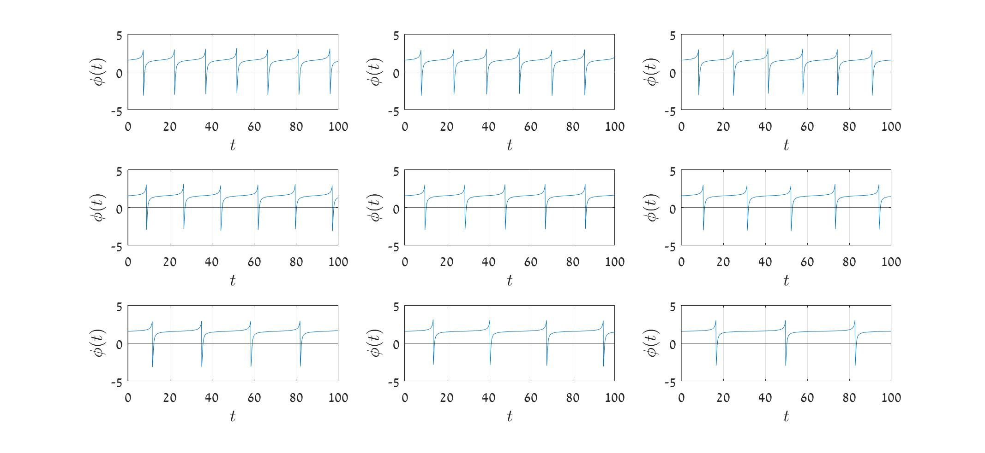
Phase Time Response
$$B=3 ;Kε\left[1.002,1.01\right]$$

Slide 22
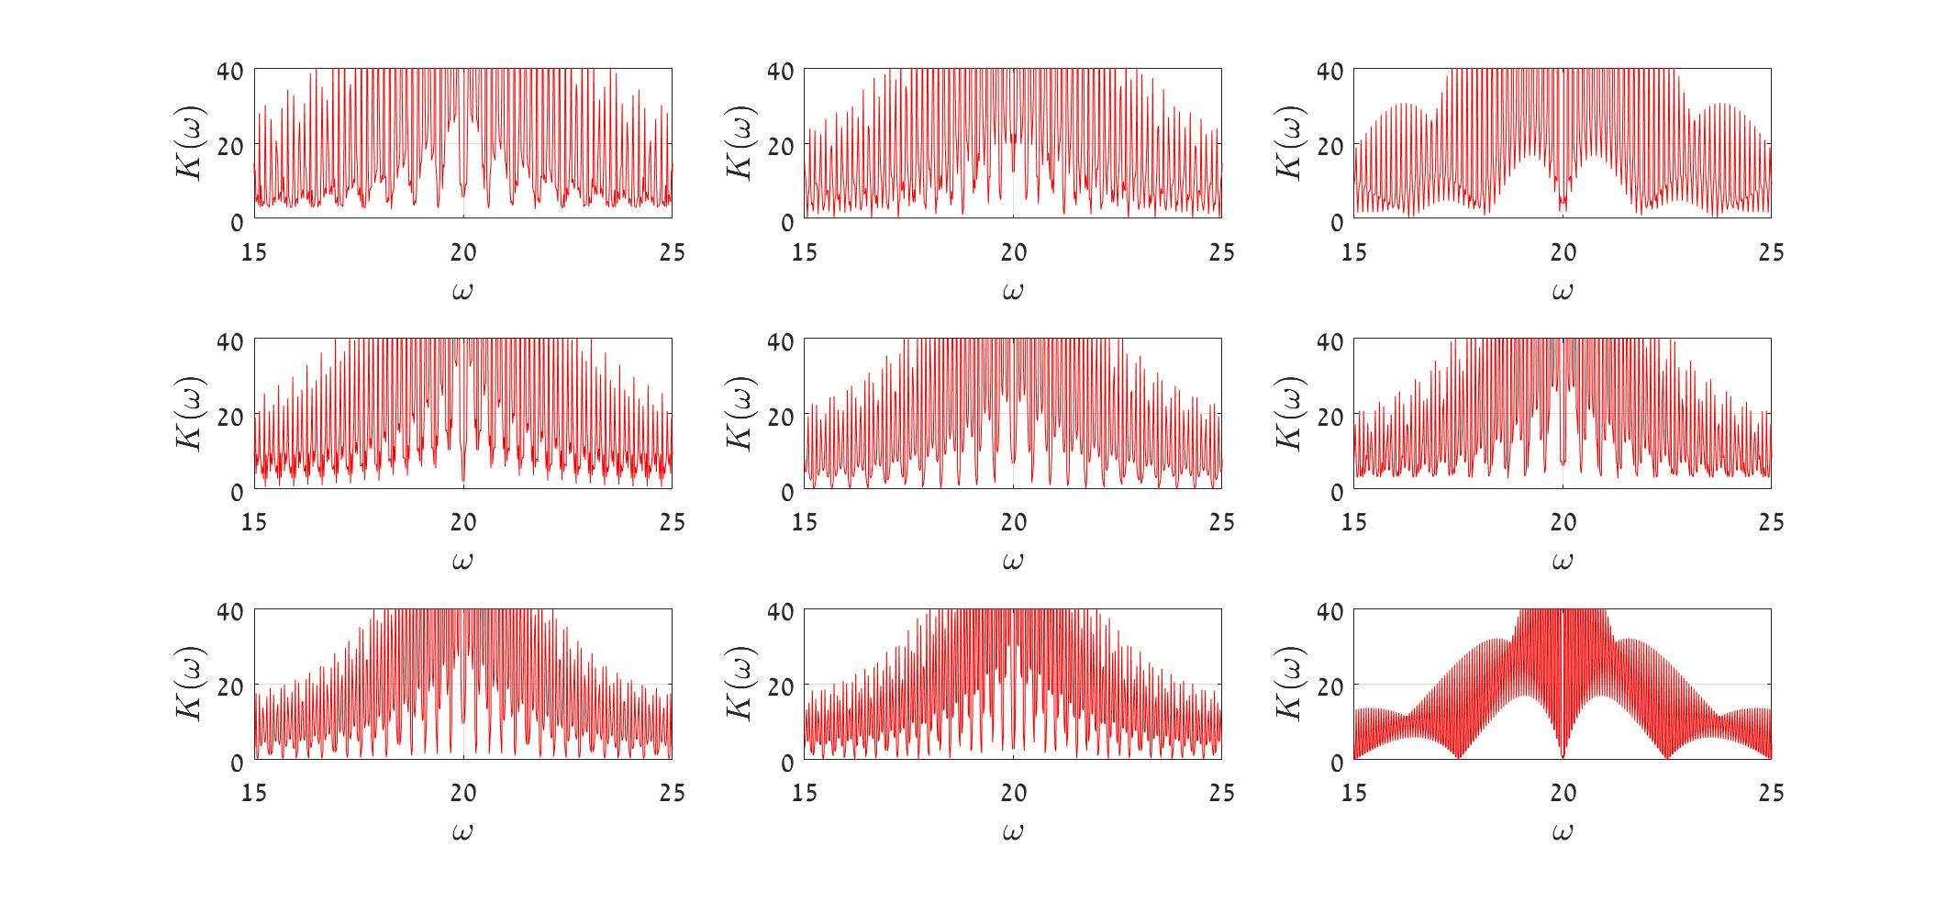
Phase Frequency Response
$$B=3 ;Kε\left[1.002,1.01\right]$$

Slide 23
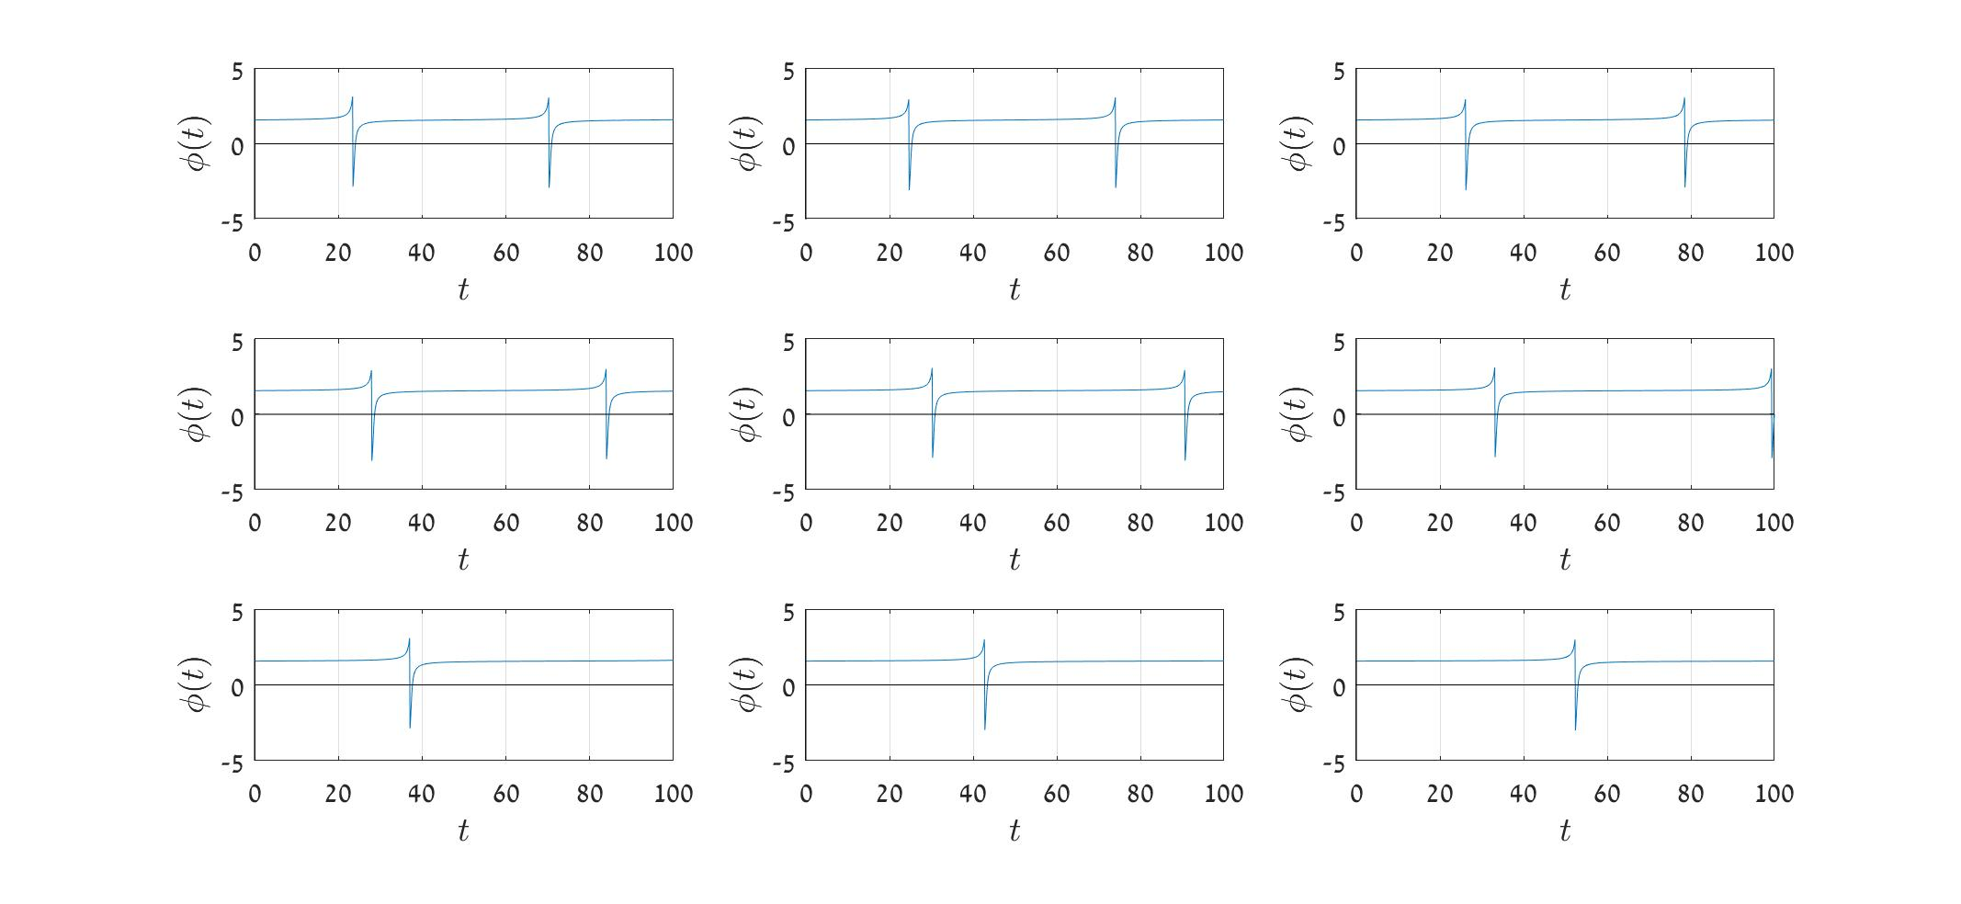
Phase Time Response
$$B=3 ;Kε\left[1.0002,1.001\right]$$

Slide 24
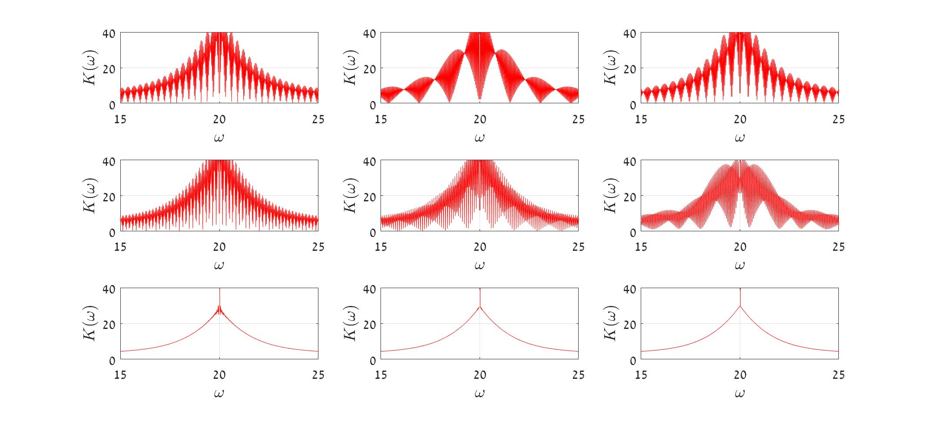
Phase Frequency Response
$$B=3 ;Kε\left[1.0002,1.001\right]$$

Slide 25
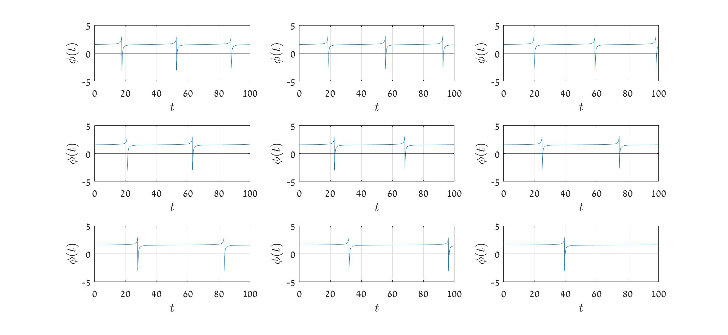
Phase Time Response
$$B=4 ;Kε\left[1.0002,1.001\right]$$

Slide 26
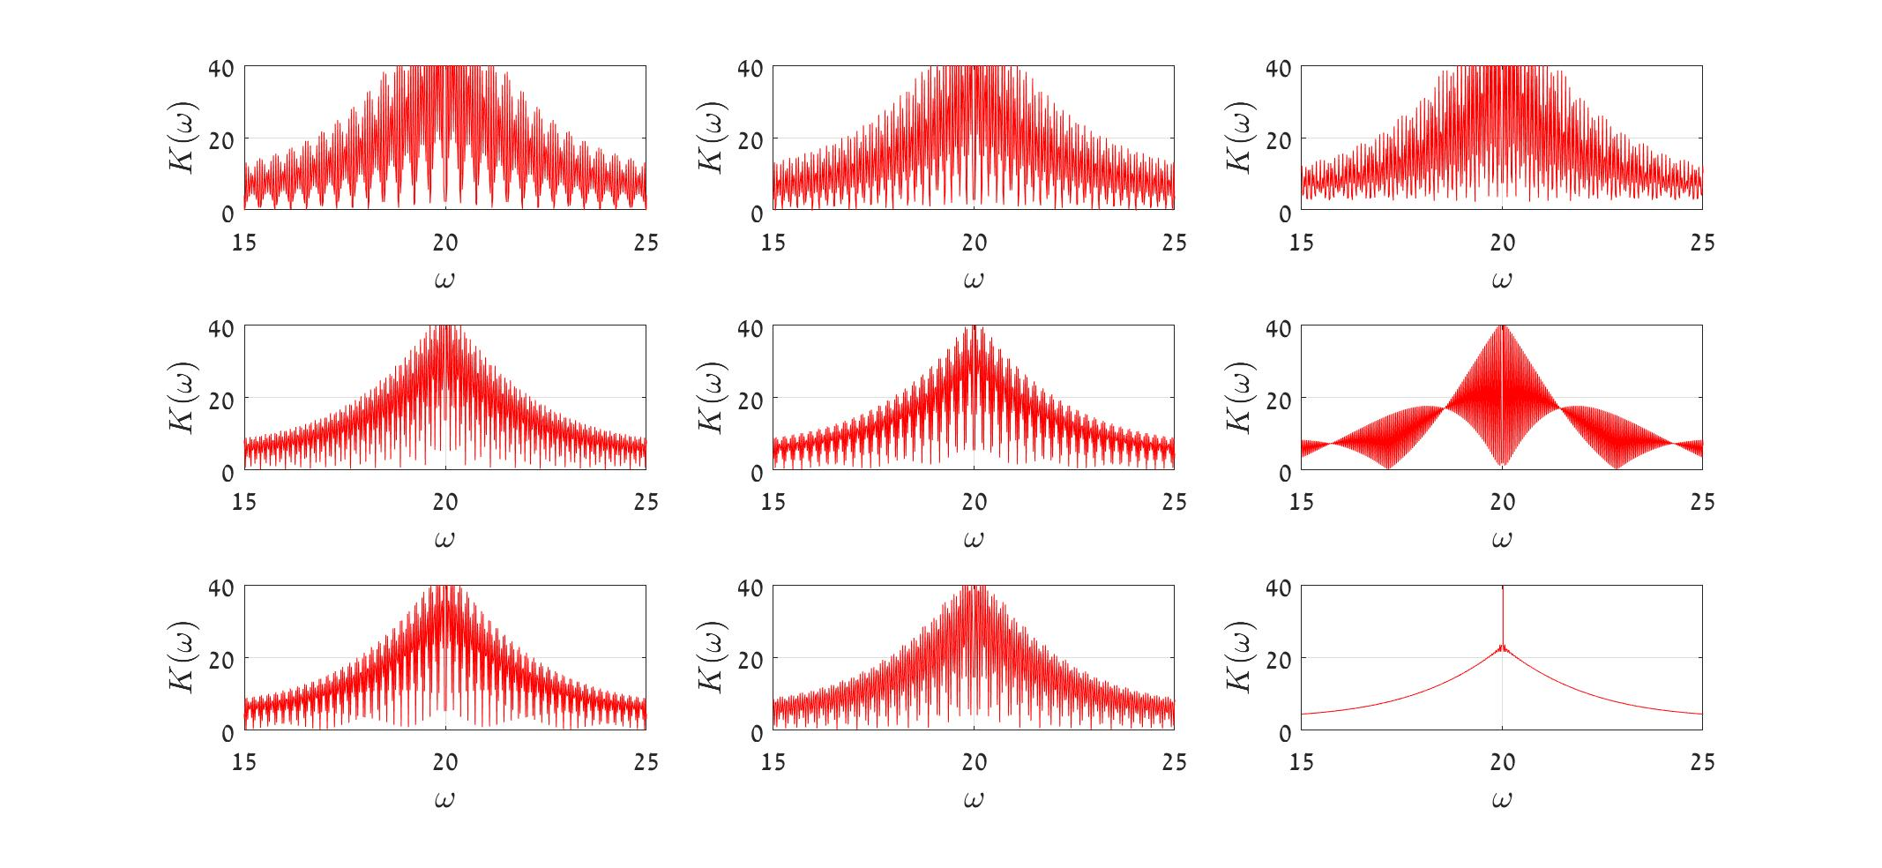
Phase Frequency Response
$$B=4 ;Kε\left[1.0002,1.001\right]$$

Slide 27
Observations and Conclusions
The complete model simulates a beam well
The control function is satisfactory
The system dynamics can be reduced to a simple model that can be applicable to MEMS with suiteable parameters
The model is suiteable for comb extraction
Values of the parameters highly effect the comb density and overall appearance

Slide 28
Future Work
Defining physical parameters for MEMS
Performing additional simulations on both models
Constructing a physical model and perform experiments
Compare results and repeat to achieve an optimized model

